Slide 1

Roots of Rotary RLI - Part 1
Notes:
Begin the session:
District Chair welcomes group and introduces District Leadership
Introduce self and session
Describe format for the session
Talk about what materials are available and/or where they can be found
Participant materials accessed online as directed in registration confirmation

Slide 2
Goals:
Discuss
Discuss Rotary’s Guiding Principles
Develop
Develop Understanding of What Rotary’s Guiding Principles Mean Today
Recognize
Recognize the Value of Rotary’s History, Administration and Organization
Reflect
Reflect on How this Understanding Affects Your Role and the Community’s Role in the Community and World
Notes:
Review Session Goals, where this course fits into the Membership curriculum of RLI
Point out INS-ROR 2 – People of Action Campaign
The Participant Manual provides relevant resources for participants with thought provoking questions and activities. Some content and activities provided during this session will supplement but not necessarily directly follow what is found in the participant manual.

Slide 3

Rotary Comes with a Set of Instructions
Object of Rotary
Avenues of Service
Code of Conduct
Four Way Test
Where can new Rotarians find them? (CHAT)
Notes:
Point out “Rotary’s Set of Instructions listed on the slide
Ask participants the question:
Where do you find these Rotary Documents? Raise your VIRTUAL Hand and unmute to respond
Respond to ideas offered by the group
If not already mentioned share places where they are located
RI, District and Club websites
Rotarian Magazine (There’s always a page about 2/3 of the way through)
RLI Participant Manual Part 2 Rotary & Ethics

Slide 4
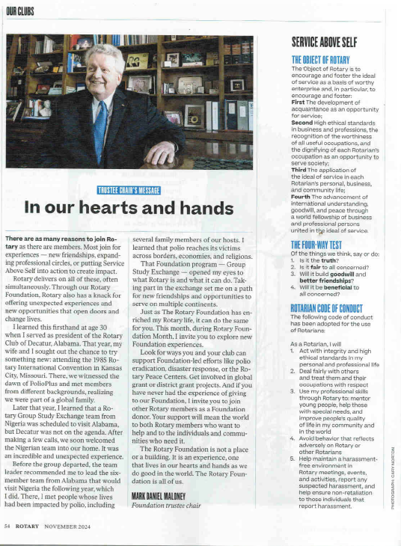
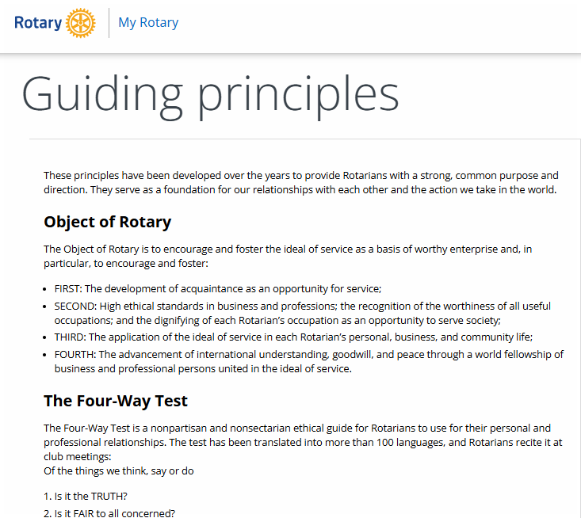
Found in the Rotary Magazine and on My.Rotary
Where can new Rotarians find them? (CHAT)
Notes:
Found online at https://my.rotary.org/en/guiding-principles
Or in The Rotarian

Slide 5
Guiding Principles of Rotary
THE OBJECT OF ROTARY
The Object of Rotary is to encourage and foster the ideal of service as a basis of worthy enterprise and, in particular, to encourage and foster:
The development of acquaintance as an opportunity for service;
High ethical standards in business and professions, the recognition of the worthiness of all useful occupations, and the dignifying of each Rotarian’s occupation as an opportunity to serve society;
The application of the ideal of service in each Rotarian’s personal, business and community life;
The advancement of international understanding, goodwill and peace through a world fellowship of business and professional persons united in the ideal of service.
Notes:
Set up the rest of the session with the following: For the next 30-45 minutes we will be looking into the history of Rotary or our ROOTS, and find out some interesting things about from where we have come as an organization.
Using the following slides briefly review all the guiding principles of Rotary.
Discuss the Object of Rotary with the participants
Point out how service is built into all four statements
Advance through next couple of slides fairly quickly as you point out guiding principles
============================================
Additional comments: The Object of Rotary has evolved over the years. The first constitution (1906) had three objects: promotion of business interests, good fellowship, and advancement of community interests. It evolved to six objects by 1920 to include higher standards of service and international service. The final revision, 1951, had one “Object of Rotary” with the four points on the slide.

Slide 6
Avenues of Service
Club Service
Vocational Service
Community Service
International Service
Youth Service
Notes:
Point out that the early Rotarians developed the “Avenues of Service” to help guide our service activities
Set up two additional principles that form the foundation of Rotary and model behavior of Rotarians
Advance to next slide
========================================
NOTE: Youth programs have been a big part of Rotary since before the 1960s. The Youth Service was added in 2010 as “New Generations Service”, but changed to “Youth Service” in 2013 because the term “New Generations” did not translate well in certain parts of the Rotary World.

Slide 7
Two Other Guiding Principles
Rotary Code of Conduct
Act with integrity and high ethical standards in my personal and professional life
Deal Fairly with others and treat them and their occupations with respect
Use my professional skills through Rotary to mentor young people, help those with special needs and improve people’s quality of life in my community and world
Avoid behavior that reflects adversely on Rotary or other Rotarians
The Four Way Test
OF THE THINGS WE THINK SAY OR DO:
Is it the TRUTH?
Is it FAIR to all concerned?
Will it build GOODWILL and BETTER Friendships?
Will it be BENEFICIAL to all concerned?
Notes:
1. Four-way test and Code of Conduct form the foundation of Rotary and model the behavior of Rotarian

Slide 8
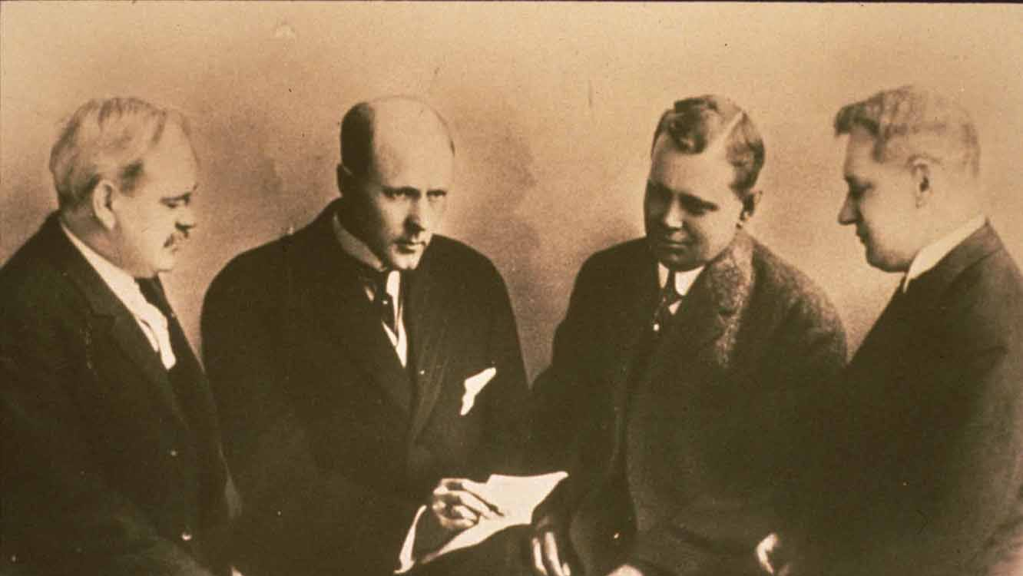
Exploring Our Roots
Notes:
Refer participants to page 3 of Part 1 Participant Manual / Roots of Rotary INS: 1 ROR - “Good to Know” Sheet for their review and reference

Slide 9
Rotary History/ Mission Quiz
Notes:
Introduce History & Mission Questionnaire: Let’s explore some history together using a True/False Rotary Questionnaire. We’ll do this quiz together. For each question select the green check for true or the red x for false under reactions.

Slide 10
Rotary History Mission (1-6)
The Rotary Club of Chicago was founded in 1905 with five members.
False
4
Rotary’s founder and first Rotary club president was Paul Harris.
False
Schiele
The second Rotary club was founded in San Francisco
True
The Rotary Club of Chicago was founded as a service organization.
False
fellowship and networking
The Rotary emblem was chosen because it symbolized the fact that Rotarians in the early days were all “big wheels” in the communities.
False
symbolizes active work
Rotary International’s current official motto is “Service above Self”.
True
Notes:
Click through the 12 questions and responses
Use the questionnaire as a starting point to discuss the history of Rotary, the evolution of many of the features of Rotary and how we got to where we are now.
Facts:
The first four members were Paul Harris, Silverster Schiele, Gustavus Loehr, and Hiram Shorey.
Paul Harris was the third Rotary Club President and the First President of Rotary International in 1912. Silverster Scheile was elected as the first president because the club meeting was held in his office, and it seemed appropriate to elect the host.
We spoke earlier about the Object of Rotary. At the time of the creation of the symbol there were six objects of Rotary, and the spokes in the wheel symbolize those objects.
There’s a second “official” motto of Who Serves Best Profits Most, but it’s not as well known as Service Above Self.

Slide 11
Rotary History Mission (7-12)
The Four-Way Test was first created in 1932.
True
The first test in the Four-Way Test is “Is it the Truth?”.
True
Rotary Youth Exchange is a program focusing on college-age students.
False
age 15-19
Rotaract Clubs can accept members ages 18-40.
False
No age limit
The priority project for Rotary International is eradicating Polio.
True
Rotary International is a 501c3.
False
501c4
TRF is a 501c3.
Notes:
Herb Taylor, a Rotarian, came up with it when working to rescue the Club Aluminum Company. He based it on rules applicable to all religions. He later served as President of Rotary International.
Before 2020 the age limit of Rotaract was 18-30. However, Rotary removed an age limit to allow people to stay in Rotaract, even if they were not ready to progress to Rotary after turning 30. Clubs may still impose their own age limits.
501(c)3 is a non-profit charitable organization and 501(c)4 is a non-profit Membership Organization. These rules apply only in the US (US IRS Tax Code). Elsewhere in the Rotary World Rotary Clubs and Foundations fall under other national laws.

Slide 12
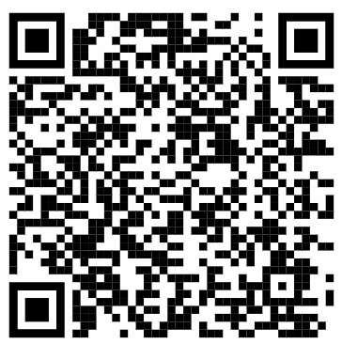
Rotary Awareness Breakouts
Notes:
Divide the team into 4 breakout groups, Assign 5 questions from Rotary awareness to each team. Give them 10 minutes to locate the answers. Encourage the use of google.
Scan the QR code with your phone or download using the link below (share to chat)
https://www.dacdb.com/Accounts/3333/Downloads/0/Virtual%20P1%20RR/Rotary%20Awareness%20Quiz.pdf
===================
Use one of the next two slides to share to breakouts, depending on group size.

Slide 13
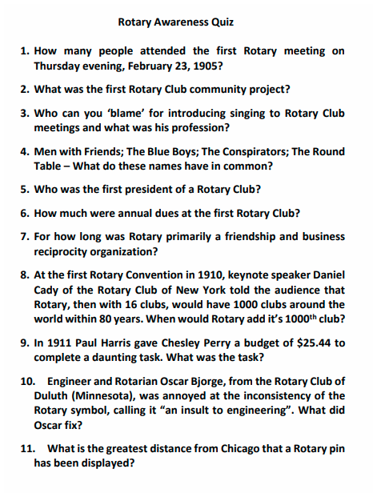
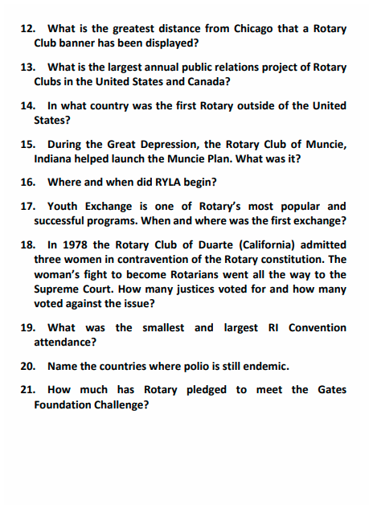
Notes:
Share this screen to breakouts to make it easier. You may even draw groups. Encourage them to use Google

Slide 14
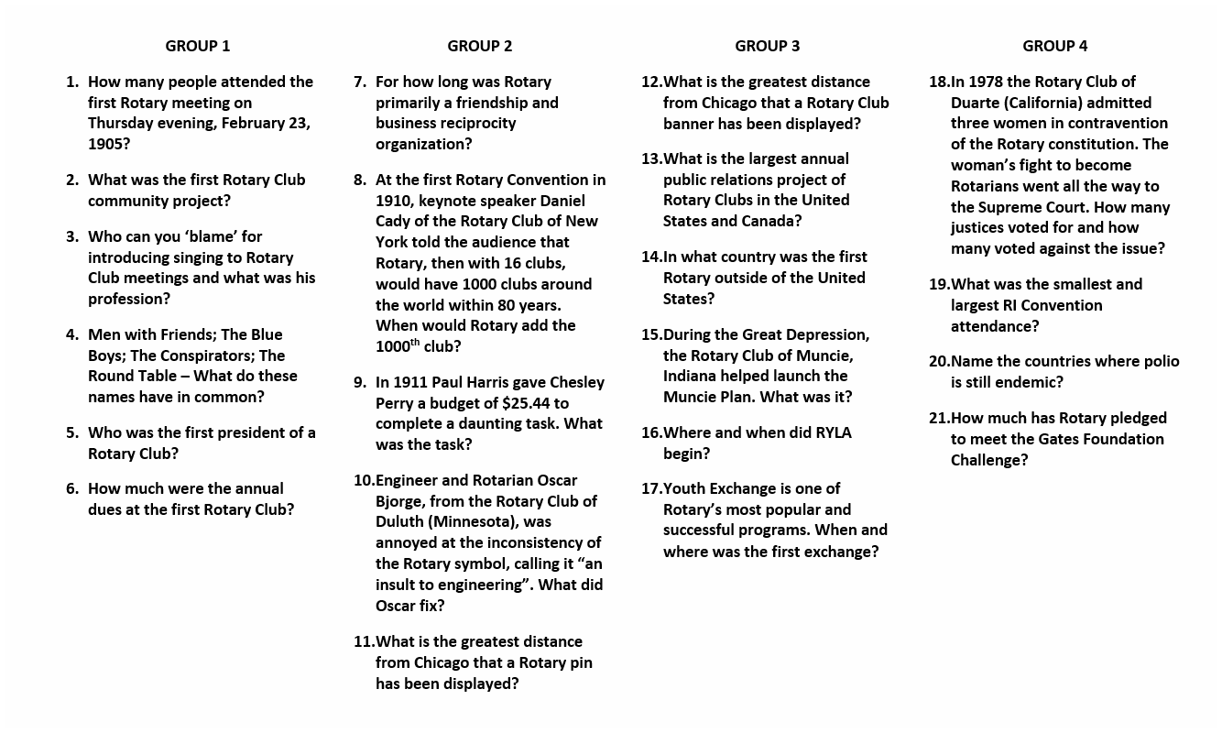
Notes:
Share this slide to breakout rooms
NOTE: in order to share to breakouts:
First start breakouts, open room
Click on SHARE
Select the check box that says “Share to Breakouts”
Start Sharing
If you leave the main room to visit a breakout, you will stop sharing. For this reason, if you visit participants in rooms, use a second computer.
https://www.dacdb.com/Accounts/3333/Downloads/0/Virtual%20P1%20RR/Rotary%20Awareness%20Quiz.pdf
Encourage participants to go on a Google Scavenger Hunt
Suggestions:
Share a timer
Share the breakout room assignments window on the shared screen (at least at first to help them find out which room they are in.)

Slide 15
Rotary Awareness
14
In what country was the first Rotary outside of the United States?
The first non-USA Rotary Club was in Winnipeg, Canada, 2010 (Dublin, Ireland, first outside of North American on 22 February 1911.)
1
How many people attended the first Rotary meeting on Thursday evening, February 23, 1905?
Four – Paul Harris, Silvester Schiele and Hiram Shorey met in Gustavus Loehr’s office.
8
At the first Rotary Convention in 1910, keynote speaker Daniel Cady of the Rotary Club of New York told the audience that Rotary then with 16 clubs, would have 1000 clubs around the world within 80 years. When would Rotary add the 1000th club?
The 1000th Rotary Club was added in 1921, only 11 years after Cady’s speech.
13
What is the largest annual public relations project of Rotary Clubs in the United States and Canada?
The Rotary float in the Rose Parade is seen by between 250-million and 1-billion people every year. Every Rotarian in District 5280 and adjacent districts contributes $3 annually which is collected in their district dues.
5
Who was the first president of a Rotary Club?
Paul Harris nominated Silvester Schiele because Paul preferred to work behind the scenes to attract new members.
15
During the Great Depression, the Rotary Club of Muncie, Indiana helped launch the Muncie Plan.
What was it?
The Muncie Rotary Club promoted home improvement to boost sales at struggling hardware stores and reduce 80 percent unemployment rate among construction workers and tradesman. The plan was successful.
Notes:
As time allows review the Rotary Awareness quiz clicking the questions and answers. Have the spokesperson for the team owning the question call out the answer.

Slide 16
Rotary Awareness
7
For how long was Rotary primarily a friendship and business reciprocity organization?
Only about two years; then the club added a third objective: to perform civic service.
19
What was the smallest and largest RI Convention attendance?
The smallest convention was the first in 1910 with 60 attendees. The largest was in 2004 in Osaka, Japan with 43,381 registrants.
2
What was the first Rotary Club community project?
A ‘comfort station’ in downtown Chicago. Public restrooms were typically found only in saloons at that time, and unaccompanied women were not permitted to enter saloons.
18
In 1978 the Rotary Club of Duarte (California) admitted three women in contravention of the Rotary constitution. The woman’s fight to become Rotarians went all the way to the Supreme Court. How many justices voted for and how many voted against the issue?
The Supreme Court, in a 7-0 decision in 1987 agreed that clubs could admit women. Sylvia Whitlock was the first president of the Duarte Club and therefore the first woman president of any Rotary Club.
12
What is the greatest distance from Chicago that a Rotary Club banner has been displayed?
Astronaut Frank Borman, of the Rotary Club of Space Center Houston, took a club banner on his orbit around the moon in Apollo 8.
16
Where and when did RYLA begin?
RYLA, the Rotary Youth Leadership Awards, began in 1959 by Rotarians from Queensland, Australia, organized a weeklong conference for outstanding young people. In 1971 the RI Board officially adopted RYLA as a youth program.

Slide 17
Rotary Awareness
10
Engineer and Rotarian Oscar Bjorge, from the Rotary Club of Duluth (Minnesota), was annoyed at the inconsistency of the Rotary symbol, calling it “an insult to engineering”. What did Oscar fix?
Oscar Bjorge standardized the Rotary wheel with six (6) spokes, 24 teeth and a keyway “because we are workers, not idlers.”
21
How much has Rotary pledged to meet the Gates Foundation Challenge?
In 2007 Rotary pledged in $100 million to match the $100 million in challenge grants received from the Bill and Melinda Gates Foundation. Over the years the challenge has increased currently $50 million a year matched 2 to 1.
11
What is the greatest distance from Chicago that a Rotary pin has been displayed?
Astronaut Buzz Aldrin, an honorary Rotarian of the Rotary Club of Spring Lake-Brielle, New Jersey, where his father was a member, planted a Four-Way Test pin on the moon when he landed
Apollo 11.
3
Who can you ‘blame’ for introducing singing to Rotary Club meetings and what was his profession?
Harry Ruggles - printer
9
In 1911 Paul Harris gave Chesley Perry a budget of $25.44 to complete a daunting task. What was the task?
To mimeograph and mail a new publication, The National Rotarian, to all 2000 Rotarians in the 23 clubs nationwide.
17
Youth Exchange is one of Rotary’s most popular and successful programs. When and where was the first exchange?
The first youth exchange was when the Rotary Club of Copenhagen Denmark arranged to host several American boys in 1921.

Slide 18
Rotary Awareness
6
How much were annual dues at the first Rotary Club?
There were no dues at the first Rotary Club. The group voted there would be no dues and all club expenses would be paid from 50 cent fines.
20
Name the countries where polio is still endemic?
Afghanistan and Pakistan have yet to become polio free. All other countries and regions across the globe have been certified polio free.
4
Men with Friends; The Blue Boys; The Conspirators; The Round Table – What do these names have in common?
At the third meeting of the group in Chicago that would become Rotary, each name was considered for the new club.

Slide 19

Rotary from 1907 to the Present
Do the issues addressed in the previous activity connect to things you do in your club?
What are your thoughts concerning how Rotary’s History led to what the organization is today?
Notes:
Connect the history of Rotary to the present state of the organization
Fast forward 100+ years after Rotary’s founding. How do some of the issues addressed in these ‘tests’ relate to what you might be doing in your club today? How did Rotary’s history lead to what the organization is today?
Spend about 5 minutes in this discussion

Slide 20

People of Action Campaign
Notes:
Introduce “People of Action” Campaign
Rotary developed the “People of Action” Campaign. Insert ROR-2 contains text from Rotary’s People of Action Campaign.
Refer to People of Action as a contemporary and “action-oriented” which takes on many aspects of The Object of Rotary.
Encourage participants to further explore this program
Provide links on where to find this resource
https://www.rotary.org/en/help-launch-new-global-ad-campaign-people-action
https://www.dacdb.com/Rotary/Accounts/5960/Downloads/0/Resources/Public_Image/poacampaignoverviewen.PDF
Discussion Prompts
Introduction to "People of Action"
What does "People of Action" mean to you in the context of Rotary?
How do you think this campaign reflects Rotary's core values?
Connecting to The Object of Rotary
Which aspects of The Object of Rotary do you see represented in the "People of Action" campaign?
How does this campaign help Rotary achieve its mission of service, leadership, and fellowship?
Impact on Local Clubs
How could your club use the "People of Action" campaign to promote its initiatives?
Can you think of specific projects in your club that align with the campaign’s themes?
Exploring Personal and Club Roles
What actions can you or your club take to embody the "People of Action" spirit?
How can this campaign help recruit new members or engage existing ones?
Future Opportunities
What opportunities do you see for using the "People of Action" branding in your community?
How can embracing this campaign shape the future of your club’s outreach and public image?

Slide 21
For Your Consideration…..
How does your new knowledge of Rotary History change your perception of what it means to be a Rotarian?
Notes:
To end this session, provide the above question for reflection – give them a minute to read the slide
Give an opportunity for participants to share their thoughts
This is a reflection question for the participants and a last opportunity for them to comment on the session
There are no wrong answers and facilitators should make connections between our individual “INSTRUCTIONS”, the Object of Rotary and other tenets of our organization, like the 5 Avenues of Service, “Service Above Self” and the great things Rotarians do in their clubs, communities and around the world
They are part of a distinguished history of collective and individual service called Rotary. These tenets are the Roots of Rotary

